Slide 1
Igniting Your Power Through Mentorship
Brought to you by: The WINiT 1:1 Mentoring Program Committee
Notes:
A WINiT by GBTA member collaboration initiative
Mary Ellen quick audience hand raise questions to kick off:
How many people have had a mentor relationship?
How many great?
How many not so great?
How many have hesitated getting a mentor because it seems overwhelming or intimidating?

Slide 2
Igniting Your Power Through Mentorship
Notes:
Why is it important to give back as a mentor?
From your experience, what makes a good mentee and how do you suggest they approach the relationship with their mentor?
What makes a good mentor from a mentee perspective?
From your experience, you refer to the mentee imposter syndrome issue. Please explain this? (don’t be afraid to raise your hand or approach someone for mentorship)

Slide 3
Audience Questions
Have you been in a mentor relationship that has had a positive impact on you personally?
Yes
No
If so, was your Mentor a male or female?
Male
Female
Notes:
Mary Ellen – show of hands

Slide 4
Audience Questions
What was most impactful from your mentoring experience?
Boosted confidence/courage
Career advancement
Leadership development

Slide 5
Benefits of a Mentoring Program
63%
Employees identify mentoring and coaching as their preferred method to learn.
91%
85%
90%
70%
More confident in handling new challenges
Quality of work has improved.
Learned new skills and knowledge for job
Ambition to take on more responsibility
Source: Qooper mentee stats -

Slide 6
Introducing The WINiT by GBTA Mentoring Program
WINiT by GBTA has partnered with Qooper, a leading online mentoring platform designed to support the mentor/mentee relationship with tools, learning and an engaging experience.
Our mentoring programs are designed to last for three months with the option to continue, pause, or celebrate success.

Slide 7
A modern virtual mentorship platform for mentors and mentees to connect, engage and develop.

Slide 8
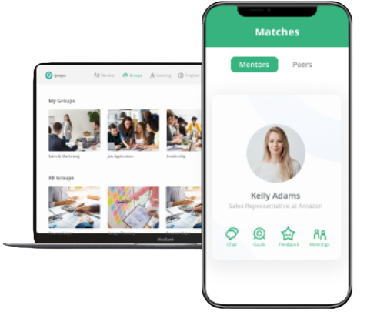
Engage on the Qooper Mentorship Platform & App
1:1 Mentoring
Training
Resources
Events
Reverse
Mentoring
Goals

Slide 9
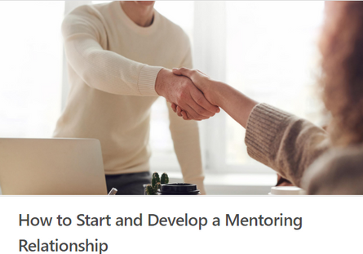
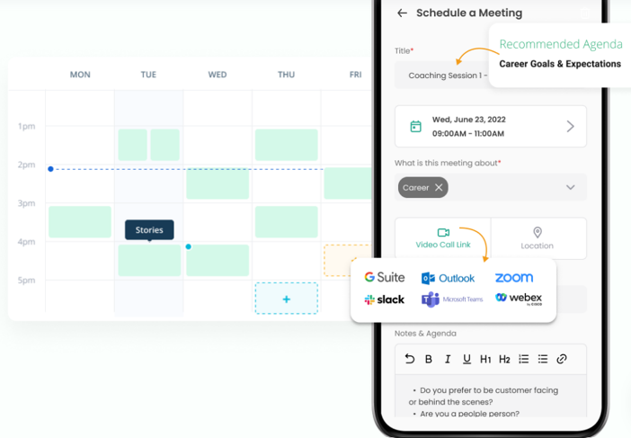
Mentor and Mentee
Training Modules
Integrated meeting scheduler

Slide 10
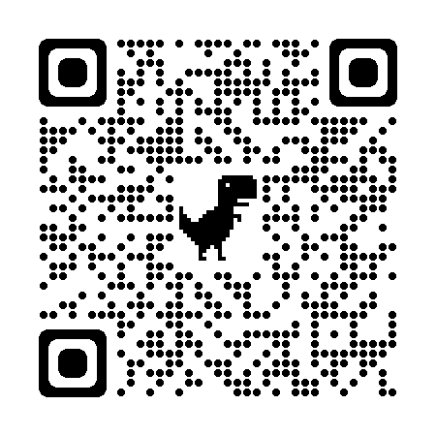
Enroll Today! https://mentoring.qooper.io/join/444620

Slide 11
Thank you
Win It Together
Notes:
We are all qualified to be mentors
Everyone has something to give back – some one invested in you, pay it forward

